Slide 1
SDLC models
Traditional and Agile
Software Development Life Cycle models
Levente_Varga1@epam.com
CONFIDENTIAL | © EPAM Systems, Inc.

Slide 2
Introduction
SDLC – Software development life cycle
Contains the activities (business practices) which are performed during the life cycle of software development
Usually 6-8 steps:
  Planning
  Requirements
  Design
  Build/Code
  Document
  Test
  Deploy
  Maintain
CONFIDENTIAL | © EPAM Systems, Inc.

Slide 3
Development models
Waterfall model
Everything needs to be defined early.
High focus on documentation.
Sequential flow control.
Hard to push feedback up.
Hardly supports iteration.
Not reactive to changes.
Still with us today.
CONFIDENTIAL | © EPAM Systems, Inc.

Slide 4
Development models
Waterfall model
Need, wish, policy, law
User requirements
System requirements
Global design
Detailed design
Implementation
Testing
CONFIDENTIAL | © EPAM Systems, Inc.

Slide 5
Development models
V-model
Need, wish, policy, law
Operational system
User requirements
Acceptance test execution
System requirements
System test execution
Global design
Integration test execution
Detailed design
Component test execution
Implementation
CONFIDENTIAL | © EPAM Systems, Inc.

Slide 6
Development models
Incremental/iterative models (general)
In every iteration (time, the process of doing something again and again) we build an increment (something added)
Increment – What are we building? Splitting the delivery process into sequential phases
Iteration – How are we building? What phases are repeated over and over?
Splitting up.
Usually equal length phases.
First serves as a base, sets up further phases.
Early release.
Supports early and dynamic feedback.
Cost (early vs. total).
Prototyping, RAD, RUP, Agile.
CONFIDENTIAL | © EPAM Systems, Inc.

Slide 7
Development models
Phase 1
Define
Develop
Build
Test
Implement
Phase 2
Define
Develop
Build
Test
Implement
Phase 3
Define
Develop
Build
Test
Implement
Incremental/iterative models (general)
CONFIDENTIAL | © EPAM Systems, Inc.

Slide 8
Development models
iterative models
Analysis and design
Coding
Testing
Planning
Requirements
Evaluation
Inintial planning
Deployment
CONFIDENTIAL | © EPAM Systems, Inc.

Slide 9
Development models
Hybrid incremental model
Need, wish, policy, law
User requirements
Acceptance test execution
System requirements
System test execution
Analysis
Coding
Testing
Integration test execution
WATERFALL
WATERFALL
CONFIDENTIAL | © EPAM Systems, Inc.

Slide 10
Development models - optional
Rad - Rapid Application Development
First a prototype is created based on user design (workshops, focus groups)
Promotes parallel prototyping, each component of the software is created as a prototype
The prototype can be re-done or changed any number of time, as necessary
Each component is built based on RAD, then integrated
The final cutover phase takes the product into production
Used by Spotify, Uber, Airbnb – had to react quickly to a changing market, good idea and integrating user feedback is essential to fight the competition
Advantages
  Reduced development time (less time spent on planning and documentation and modules can be reused)
  Increases reusability (prototypes can be reused inside the app and to build similar apps as well)
  Early and constant customer feedback
  Minimal integration issues
Disadvantages
  Only modular systems can be built with RAD
  Highly skilled developers are required (who also understand business requirements)
  Only good for software which requires short development time
CONFIDENTIAL | © EPAM Systems, Inc.

Slide 11
Development models - optional
Rad phases
Demonstrate
Refine
Develop
Anaysis and quick design
Testing
Deployment
Protoype
lifecycle
CONFIDENTIAL | © EPAM Systems, Inc.

Slide 12
Development models - optional
RUP – Rational Unified Process
Belongs to the incremental model family from Rational, a division of IBM.
It helps parallelization of the workforce, for better utilization, so it is useful for the large scale, like hundreds of developers.
Phases
  Inception – Determine resource needs.
  Elaboration – Architecture and further resource evaluation.
  Construction – Design, coding, testing, completing.
  Transition – Release, feedback, final updates.
CONFIDENTIAL | © EPAM Systems, Inc.

Slide 13
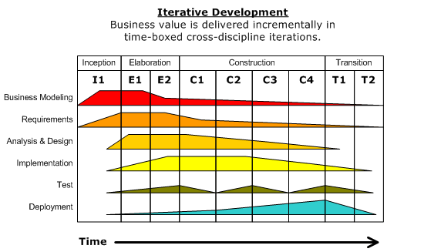
Development models - optional
RUP – Rational Unified Process
CONFIDENTIAL | © EPAM Systems, Inc.

Slide 14
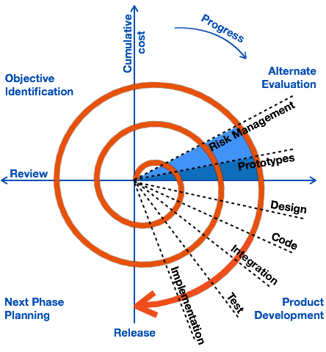
Development models - optional
Spiral model
Early agile – 4 defined phases following each other in repetition
Supports prototyping
Phase – planning – objective identification (technical + US/Vision)
Phase – prototyping with risk assessment
Phase – if risks are low, feature accepted – development phase
Phase – feedback/retro – to help planning the next phase
Feedback is very important, it drives the delivery. Video games can be developed this way, or the Chinese facebook for example (Started as a chat, then video calls, then payment)
In case the feedback is negative, the feature is not carried on. In case the product receives bad feedback, then a new product development is started.
CONFIDENTIAL | © EPAM Systems, Inc.
Notes:
Korai agile – 4 jól meghatározott fázis követi egymást és ezek időben ismétlődnek.
4 fázis – támogatja a prototipizálást
Fázis – planning – objective identification (technical + US/Vision)
Fázis – prototyping with risk assessment
Fázis – if risks are low, feature accepted – development phase
Fázis – feedback/retro – to help planning the next phase
Feedback is very important, it drives the delivery. Video games can be developed this way, or the Chinese facebook for example (Started as a chat, then video calls, then payment. Etc)
In case the feedback is negative, the feature is not carried on. In case the product receives bad feedback, then a new product development is started.

Slide 15
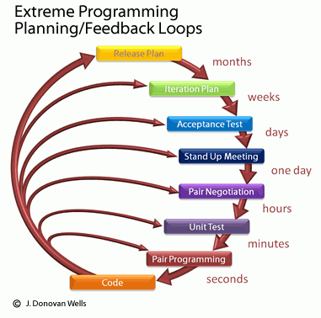
Development models - optional
Extreme Programming
Is a software development methodology intended to improve software quality and responsiveness to changing customer requirements.
It contains activities which supports to create good quality code from the start and aims to avoid creating unnecessary code.
Each activity has an expected feedback loop set.
The activities/practices can be found in other models as well.
CONFIDENTIAL | © EPAM Systems, Inc.

Slide 16
Development models - optional
Fine-scale feedback - Extreme Programming Best Practices – I.
Pair programming – Two people work in tandem on the same problem. Rotating partners is advised.
Planning game – This is how most of the planning for the project takes place.
  Release planning – Where determinations are made regarding what is required for impending releases.
    Exploration phase – Story cards for the most valuable requirements.
    Commitment phase – Planning and commitments from the team.
    Steering phase – Adjust previous plans.
  Iteration planning – Follows the release planning.
    Exploration phase – Requirements are written down.
    Commitment phase – Tasks are assigned and scheduled.
    Steering phase – Upon development competition results are checked against the original cards.
Test-driven development – Tests are created first based on requirements, only then is code developed against them.
Whole team – Include customers and clients throughout the entire process and use everyone’s feedback.
CONFIDENTIAL | © EPAM Systems, Inc.

Slide 17
Development models - optional
Continuous process - Extreme Programming Best Practices – II.
Continuous Integration
  All code is merged into one repository (Master).
  Integrations tests ensure stability.
  Early and frequent integration reveals integration issues at the earliest possible time.
  Releases can be assembled in a short time.
  Continuous Delivery is the next step.
Code refactoring
  Improve and redesign the structure of already existing code.
  Behavior should not be modified.
  Fixing naming conventions.
  Reducing repeated code to a method or function.
Small releases – Release frequently (per hour/day/week/iteration) to show the whole team the current status.
CONFIDENTIAL | © EPAM Systems, Inc.

Slide 18
Development models - optional
Shared Understanding - Extreme Programming Best Practices – III.
Coding standards
  Set of best practices within the code itself, formatting and style
  Applies to everyone who contributes
  Promotes better understanding and readability
  Ensure continuity for future contributors
Collective code ownership – Everyone should be able to modify all (or at least multiple) parts of the code
Simple design
  If there is a choice between simple and complex, always choose the simplest
  This applies for components and code snippets as well
  KISS – Keep It Simple, Stupid
System metaphor
  Everyone in the team should understand the whole system at least on a high level
  An easy way to reach this is to have a metaphor to everything, and use it in the naming conventions
CONFIDENTIAL | © EPAM Systems, Inc.

Slide 19
Development models - optional
Programmer welfare
Extreme Programming Best Practices – IV.
Sustainable pace
  Promotes a healthy work-life balance
  No work outside of the normal working hours
  No overtimes, no “crunch time”
CONFIDENTIAL | © EPAM Systems, Inc.

Slide 20
Development models
Agile manifesto
We are uncovering better ways of developing software by doing it and helping others do it.
Through this work we have come to value:
Individuals and interactions over processes and tools
Working software over comprehensive documentation
Customer collaboration over contract negotiation
Responding to change over following a plan
That is, while there is value in the items on the right, we value the items on the left more.
https://agilemanifesto.org
CONFIDENTIAL | © EPAM Systems, Inc.

Slide 21
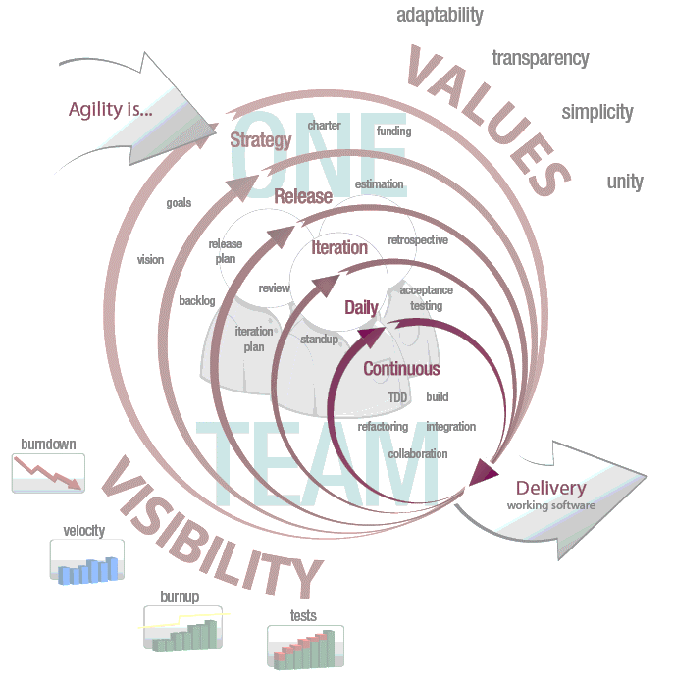
Development models
The scrum method overview
Artifacts
  Product Backlog
  Sprint Backlog
  Product Burn Down Chart
  Sprint Burn Down Chart
Daily Scrum Meeting
  What did you accomplish yesterday?
  What are your working on today?
  What impediments in your way?
Sprint Review
Sprint Retrospective Meeting
Time Boxing
CONFIDENTIAL | © EPAM Systems, Inc.

Slide 22
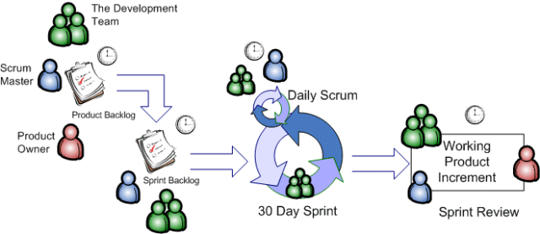
Development models
The scrum method overview
CONFIDENTIAL | © EPAM Systems, Inc.

Slide 23

Development models
The scrum - roles
A Pig and a Chicken are walking down the road.
  The Chicken says: "Hey Pig, I was thinking we should open a restaurant!„
  Pig replies: "Hm, maybe, what would we call it?"
  The Chicken responds: "How about 'ham-n-eggs’?”
  The Pig thinks for a moment and says: "No thanks. I'd be committed, but you'd only be involved."
PO, SM,
development team
Everyone else
(managers, user acceptance testers, architects)
vs
CONFIDENTIAL | © EPAM Systems, Inc.

Slide 24
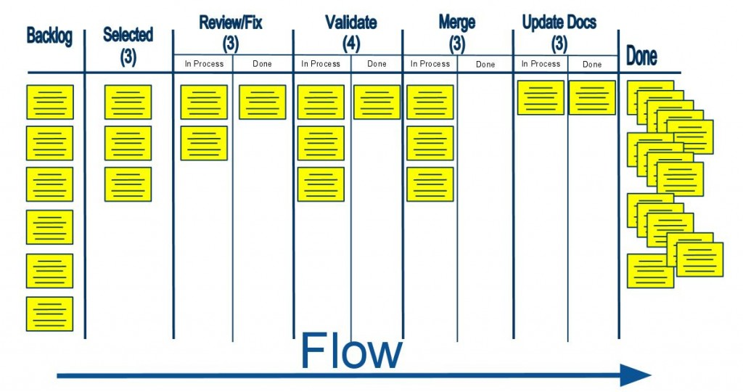
Development models
Kanban
CONFIDENTIAL | © EPAM Systems, Inc.

Slide 25
Pessimistic and optimistic estimation
CONFIDENTIAL | © EPAM Systems, Inc.

Slide 26
Why do we estimate?
Why?
We always estimate, time, money, stopping distance, our chances to get a date with the desired boy/girl, and everything
We use these estimations for making decisions about
  Investing in something, or skipping it
  Deciding between multiple options
Who?
Estimations can be done solo, or in a group
Group estimations might include
  People who are to realize the task if it needs to be done
  Experts who have done it more times than us
  The 2nd party, as an observer, or to provide details
Difficulties?
Quite hard to estimate the unknown
Not easy to be pessimistic
Estimation time is always used up
Managers think of it as the Holy Writ
Not everything is estimated
Too many plans rely on estimates
People are not universal
Changes are often not re-estimated
The skeleton falls out too late
Failures do not trigger re-estimation
Wrong people do the estimates
CONFIDENTIAL | © EPAM Systems, Inc.

Slide 27
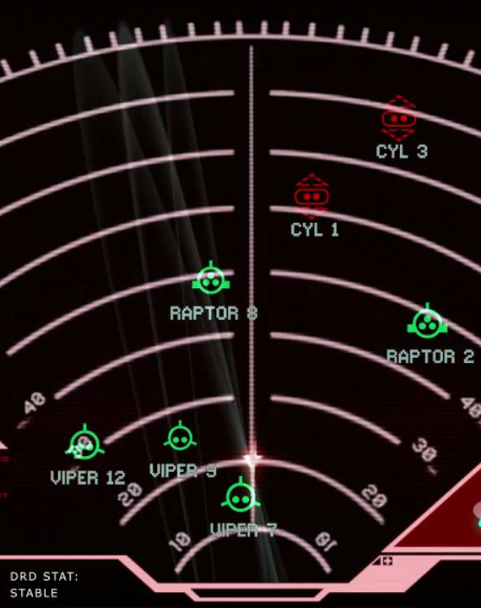
Popular estimation techniques
Planning Poker
Three Amigos / Triad
T-Shirt Sizes
Three-Point / PERT
And many more…
CONFIDENTIAL | © EPAM Systems, Inc.

Slide 28

Three-Point Estimation
It is also called PERT, as Program Evaluation and Review Technique
It provides three points (no sh*t, Sherlock)
  Pessimistic (b)
  Realistic (m)
  Optimistic (a)
Benefits
  Increased accuracy
  Risks are considered early
  Risks are shared early
Funky mathematics to go with it
Double-triangular distribution
  E = (a + 4m + b) / 6
  SD = (b − a) / 6
Triangular distribution
  E = (a + m + b) / 3
CONFIDENTIAL | © EPAM Systems, Inc.

Slide 29
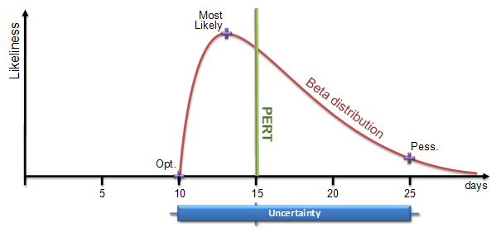
Three-Point Estimation
A Cool Graph
A boring sample of magic
For e.g.
If optimistic estimate to finish a module is 12 days, most likely is 16 days and pessimistic estimate is 18 days , the 3 point estimate is
(12 + 4 * 16 + 18)/6 = 15.67 and spread is (18-12)/6 = 1.
This in turn means 95 % probability is that module will finish by 13.67 to 17.67 days (+/- 2 days for 2 sigma level)
Also, if we go by 99% probability or 3 sigma , the spread is +/- 3 days of mean estimate…
For day to day projects, 95% confidence level is good. For mission critical projects, go for 99%. Also, since spread at 95% is +/-2 days or of 4 days, the risk is of 4/15.67 = 0.25 or 25%.
CONFIDENTIAL | © EPAM Systems, Inc.

Slide 30

Pessimistic and Optimistic Estimation
The key is simplification
  Three points -> Two points
    Pessimistic (p)
    Optimistic (o)
  Fibonacci -> Man-days
    It might already be ready, and easily available (0, 0.5)
    We need to work on it (1, 2, 3, …)
  Simple mean (m) calculation
    m = (p + o) / 2
  Adding contingency (c) in one go
    c = 0.2 * m
  Finalize (f) by simply adding them together
    f = m + c
  You call this simple?!
    This has a lot of math still!
    Show me an example!
CONFIDENTIAL | © EPAM Systems, Inc.

Slide 31
Pessimistic and Optimistic Estimation example
Task | Summary | O | P | M | C | F
TMNT-0001 | Create test report for Sprint 23 | 3 | 5 | 4 | 1 | 5
TMNT-0002 | Review requirements for Sprint 24 | 4 | 7 | 5.5 | 1.4 | 6.9
TMNT-0003 | Reclaim Cybertron | 2 | 9 | 5.5 | 1.8 | 7.3
TMNT-0004 | Expand smoke suite with Sprint 22 items | 5 | 10 | 7.5 | 2 | 9.5
TMNT-0005 | Test design for the multiple document view feature | 2 | 3 | 2.5 | 0.6 | 3.1
TMNT-0006 | Avenge the death of Alex J. Murphy | 7 | 11 | 9 | 2.2 | 11.2
TMNT-0007 | Create ramp-up plan for new the new team member | 3 | 7 | 5 | 1.4 | 6.4
TMNT-0008 | Bring swift death to the enemies of Mankind | 1 | 4 | 2.5 | 0.8 | 3.3
TMNT-0009 | Update test set user info for the new environment | 5 | 7 | 6 | 1.4 | 7.4
SUM |  | 32 | 63 | 47.5 | 12.6 | 60.1
CONFIDENTIAL | © EPAM Systems, Inc.

Slide 32
T-Shirt Size Technique
It’s one of the Agile Story Point Estimation Techniques.
It’s a relative estimation technique.
Based on the US t-shirt sizes: Small (S), Medium (M), Large (L) and Extra Large (XL) and so on.
Smaller than XS = a Task, Larger than XL = an Epic.
Allows a more dynamic approach.
PO explains, then questions follow:
  Design-related: e.g. Do we have to learn new things before starting the design/HTML/jQuery etc?
  Coding-related: e.g. Do we have any code class library ready or we have to write it from the scratch?
  Testing-related: e.g. Any specific setup required for testing?
After everyone showing their chosen t-shirt size, the team might need to debate, and redo the exercise.
  One of the smallest t-shirt size showers should explain why.
  One of the largest t-shirt size showers should explain why.
After all items are done, place them in their respective buckets.
CONFIDENTIAL | © EPAM Systems, Inc.

Slide 33
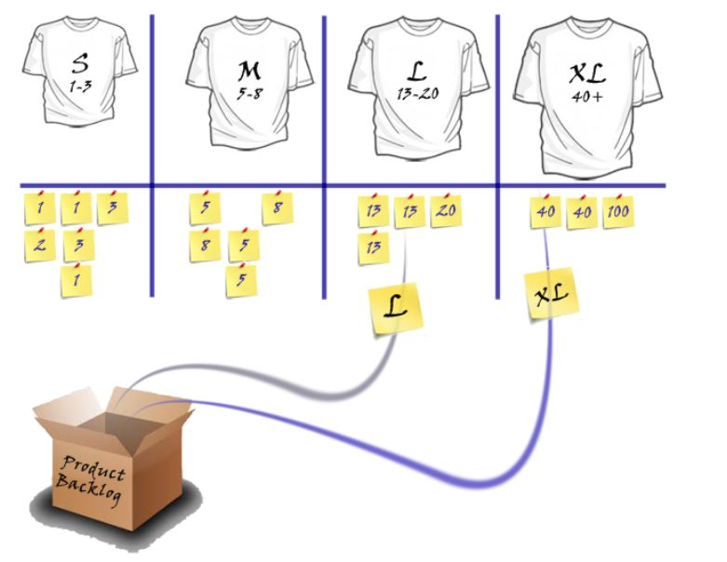
T-Shirt Size Technique
CONFIDENTIAL | © EPAM Systems, Inc.

Slide 34
Useful AGILE links
Scrum Alliance - http://www.scrumalliance.com
Mountain Goat Software - http://www.mountaingoatsoftware.com
Agile Alliance - http://agilealliance.com
VersionOne - http://www.versionone.com/Agile101/
EPAM Agile Professional Development Suite - https://www.epam.com/our-work/brochures/agile-professional-development-suite
CONFIDENTIAL | © EPAM Systems, Inc.

Slide 35
Thank you For your attention!
Levente_Varga1@EPAM.com
CONFIDENTIAL | © EPAM Systems, Inc.

